Slide 1
Opening New Avenues for Empowerment: ICTs to Access Information and Knowledge for Persons with Disabilities 20-21 June 2013, Lisbon, Portugal
Ms Irmgarda Kasinskaite-Buddeberg
Knowledge Societies Division, Communication and Information Sector
UNESCO Headquarters, Paris

Slide 2
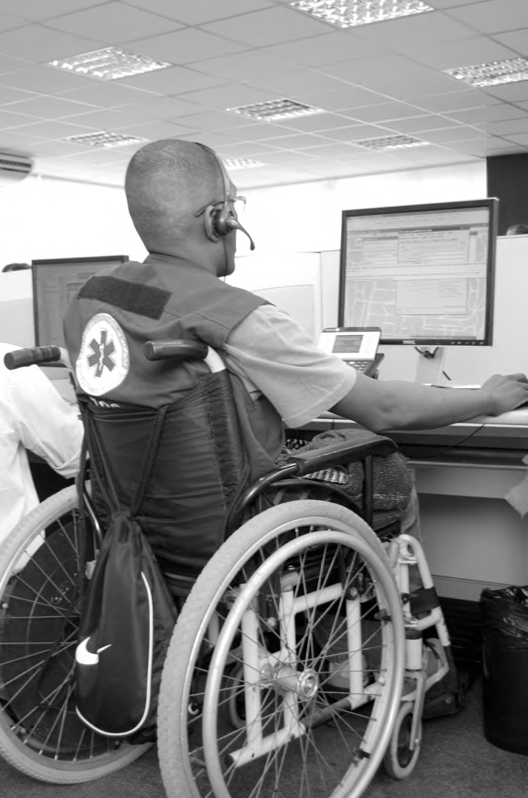
United Nations Convention on the Rights of Persons with Disabilities (2006)
132 countries have ratified the Convention
77 countries have already ratified optional protocol
Articles linked to UNESCO’s mandate :
5. Equality and non-discrimination
6. Women with disabilities
8. Awareness-raising
9. Accessibility
21. Freedom of expression and opinion and access to information
24. Education
27. Work and employment
29. Participation in political and public life
30. Participation in cultural life, recreation, leisure and sport
31. Statistics and data collection
32. International cooperation

Slide 3
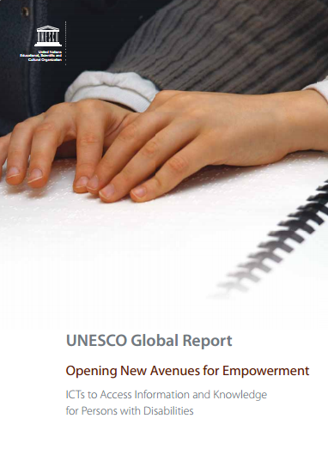
Asia-Pacific Regional Report
Eastern Europe and Central Asia Regional Report
North Africa and Arab States Regional Report
Latin American and Caribbean Regional Report
Policy recommendations for UNESCO‘s Member States on accessible, adoptive and affordable ICTs in education
for Persons with Disabilities:
National/regional education and information policies
Linkages with other policies
Existing Open Educational Resources
Existing technical solutions
Gender issues
Open Document Format
Web accessibility standards
Impact and sustainability issues
Budgetary implications and funding sources
Succesful cases studies at grassroot level
African Regional Report

Slide 4
Major objectives
Five regional studies commissioned by UNESCO with an aim to:
provide governments, civil society, industry, academia and other groups with an insight into the use of Information and Communication Technologies (ICTs) by persons with disabilities to access information and knowledge around the world;
present an overview and critical assessment of existing information and education policies and strategies as well as challenges and advantages in using ICTs to access information and knowledge for persons with disabilities;
Based on the best available information and analysis, to make recommendations for strategy formulation, action-oriented initiatives and new synergies at national, regional and international levels.

Slide 5
Finding no 1
An evolutive technology: there is a rapid rate of innovation that will render an ICTs’ definition obsolete.
The most important is not « what are the technologies ? », but
«How are current and emerging technologies being made accesible, affordable and relevant for Persons with Disabilities?»
Indeed, ICTs can help to transform the teaching and learning environment of Persons with Disabilities.

Slide 6
Finding no 2
Community
Technical skills
Practical skills
Lifelong learning
ICT
ICT
Workplace
Society
Analytical,
cognitive skills
Societal skills
Individual
Using accessible ICTs and ATs, a learning and teaching process could place in any stage of life and in all contexts.

Slide 7
Finding no 3
There are very few countries which have a dedicated one ministry for people with disabilities. In most cases, interventions for disabled people happen accross multiple agencies or ministries of government.
ICTs have also an important role in helping PWD to make the transition from education to work (from acquisition of soft skill to technical, and societal skills).
There is a need for policies that allow holistic and coherent interventions.
Policy frameworks
ICT & AT
Interven-tions
Content
Capacity building

Slide 8
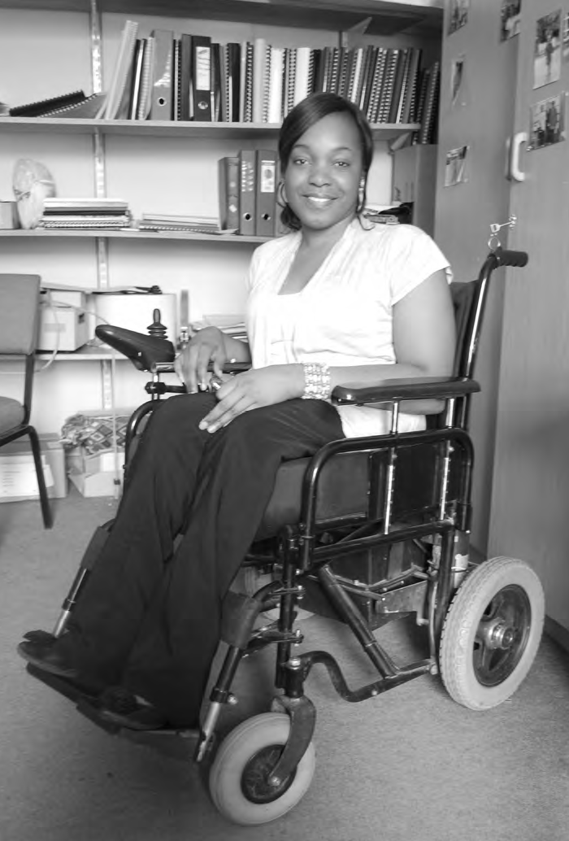
Finding no 4
The UN Convention does not give a precious definition of « disability », but recognizes that it is an evolving concept. It implies numerous societal attitudes and recognition of disability that differ accross countries.
Policy interventions need to overcome shame and social prejudices, especially in developing countries where disability is an important factor of marginalization.
A gender consideration also has to be made: girls and women with disabilities face more difficulties, stigma and discrimination.
Indeed, there is first a need of recognizing what is the disability and its characteristics and second what are the interventions that are required.

Slide 9
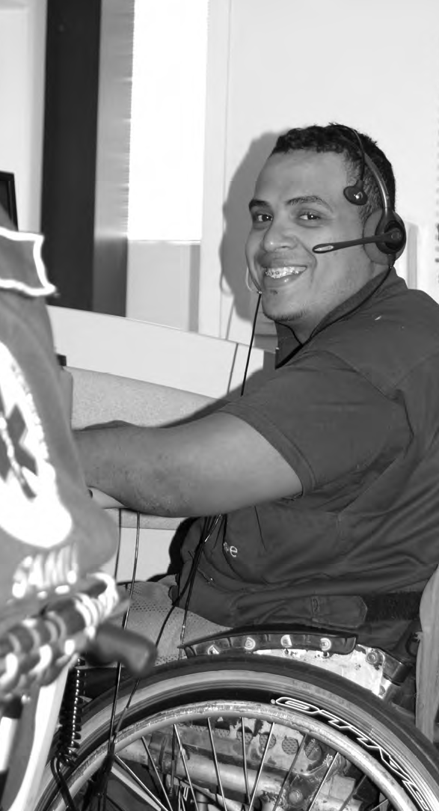
Finding no 5
Globally persons with disabilities make up some 15% of the world’s population, but there are 80% of them in developing countries which are least able to address their needs.
One of the challenge of the PWD’s empowerment is to provide innovative solutions using ICTs that are affordable, accessible and adaptable.
→ The UN Convention promotes the rights of people with disabilities, but it is a motivator. The enabling forces are national efforts and ressources. During the economical crisis governments face a lack of financial resources and this difficult situation induces serious limits into building inclusive societies. In some cases, the economic and budgetary pressures serve as a pretext of inaction.

Slide 10
Finding no 6
In order for persons with disabilities to access ICT, the technology or content must be designed to be accessible : AT and ICT must be interoperable.
The price of some mainstream AT has been decreasing and often is supplied directly with IC products at no additional cost.
But, in general, the limited availability of AT and ICTs due to its cost.
Development of Free and Open Assistive Technologies.

Slide 11
Finding no 7
Open access to scientific information
Open educational resources
Accessible -multilingual content
Access to information and knowledge for Persons with Disabilities

Slide 12
Finding no 7
The archival method used to preserve content makes a huge difference regarding the accessibility of the content.
It allows to seperate the structure from presentation and that allows persons seeking accessible formats to search and find the most accessible versions of works that meet their individual needs.
→ Accessible digital archiving and preservation of cultural heritage.

Slide 13
Follow up
18 recommendations for policy and decision makers, educators and IT industry
World Summit on the Information Society Review+10, February 2013, Paris, France
Model Policy for Accessible ICTs in Support of Inclusive Education
Awareness raising at international level through international cooperation mechanisms
Contribution to the global consultations for the preparation of the High-level meeting at UN during the General Assembly meeting in September 2013, NY, USA
Plans to develop a chapter on accessibility for UNESCO ICT Competency Framework for Teachers

Slide 14
Thank you for your attention.
Irmgarda Kasinskaite-Buddeberg
E-mail: i.kasinskaite@unesco.org
http://www.unesco.org/new/en/communication-and-information/access-to-knowledge/access-for-people-with-disabilities/
Available in English on UNESCO’s website:
http://unesdoc.unesco.org/images/0021/002197/219767e.pdf
Report will be soon available in Portuguese.

