Slide 1
Accessibility of Text European Agency for Special Needs and Inclusive Education
Notes:
Accessibility of Text European Agency for Special Needs and Inclusive Education

Slide 2
What is ‘accessibility’?
According to the United Nations Convention on the Rights of Persons with Disabilities:
… appropriate measures to ensure to persons with disabilities access, on an equal basis with others, […] to information and communications, including information and communications technologies and systems …
Accessibility means different things to different people, depending on their needs.
Notes:
What is ‘accessibility’?
According to the United Nations Convention on the Rights of Persons with Disabilities:
… appropriate measures to ensure to persons with disabilities access, on an equal basis with others, […] to information and communications, including information and communications technologies and systems …
Accessibility means different things to different people, depending on their needs.

Slide 3
Who needs accessibility?
Over 1 billion people worldwide have some form of disability. This figure will increase in the future (World Health Organization, 2014).
10% (a conservative estimate) of European population has some form of disability.
2% - 18% of the total school population (temporary or permanent educational problems).
Notes:
Why make documents accessible?
Over 1 billion people worldwide have some form of disability. This figure will increase in the future (World Health Organization, 2014).
In order to provide equitable lifelong learning opportunities, ALL learners must have access to information.

Slide 4
Why consider accessibility?
ICT is increasingly seen as a major tool in meeting individual learning needs.
In order to provide equitable lifelong learning opportunities, ALL learners must have access to information.
Access to information and accessible ICT has the potential to create synergies, which may equally benefit people with disabilities and/or special needs, the ageing population as well as all members of society.

Slide 5
Why consider accessibility of information?
Apart from the obvious benefit of giving learners access to information, accessible documents have a clear structure, so ALL users can navigate them more easily.
Taking time to set up document structures, styles and templates will save time in future.
Notes:
Benefits of accessible documents
Apart from the obvious benefit of giving learners access to information, accessible documents have a clear structure, so ALL users can navigate them more easily.
Taking time to set up document structures, styles and templates will save time in future.

Slide 6
Why is this important for the Agency?
How ICT can support people with disabilities and/or special needs has been a constant issue raised within Agency work:
ICT in Special Needs Education (1999–2001)
SEN-IST-network (2000–2003)
ICT in education for people with disabilities – Practice Review (in collaboration with IITE)
Model policy for inclusive ICTs in education (in collaboration with UNESCO and G3ict)
Accessible information provision for lifelong learning
ICT for Inclusion
ICT4IAL
Agency strives to be a model of accessibility.

Slide 7
Efforts to improve accessibility within the Agency
Setting up Word and Power Point templates to be used by all staff
Creating a Style Guide which is continuously updated, containing formatting and accessibility requirements
Providing guidance at trainings or individually for specific issues
Ensuring the accessibility of the physical environment and materials at meetings
Drafting an accessibility checklist to support event planning

Slide 8
Implications for production processes
The necessity for continuous staff training, learning and keeping up to date
Acquiring software and learning how to use it
Solving the issue of translation of alt text into all Agency languages
Taking accessibility into account for graphic design and layout
Extensive accessibility checking procedures for all public files (PDFs, PPTs, Word)

Slide 9
Main steps when creating text
In MS Word:
Using templates where Agency heading and body text styles have been created and are used to give structure to the document; sans serif typeface (Calibri), limited use of bold and italics
Attention to layout and readability of tables, numbered captions for figures and tables, etc.
In Adobe Acrobat:
tagging, setting the language, adding alt text for graphics, setting reading order, full accessibility check

Slide 10
Accessibility of an Agency publication
Early Childhood Intervention report from 2005
Converted from Word 2003 (.doc) to Word 2013 (.docx) to use accessibility checker
Notes:
Accessibility of an Agency publication
Early Childhood Intervention report from 2005
Converted from Word 2003 (.doc) to Word 2013 (.docx) to use accessibility checker

Slide 11
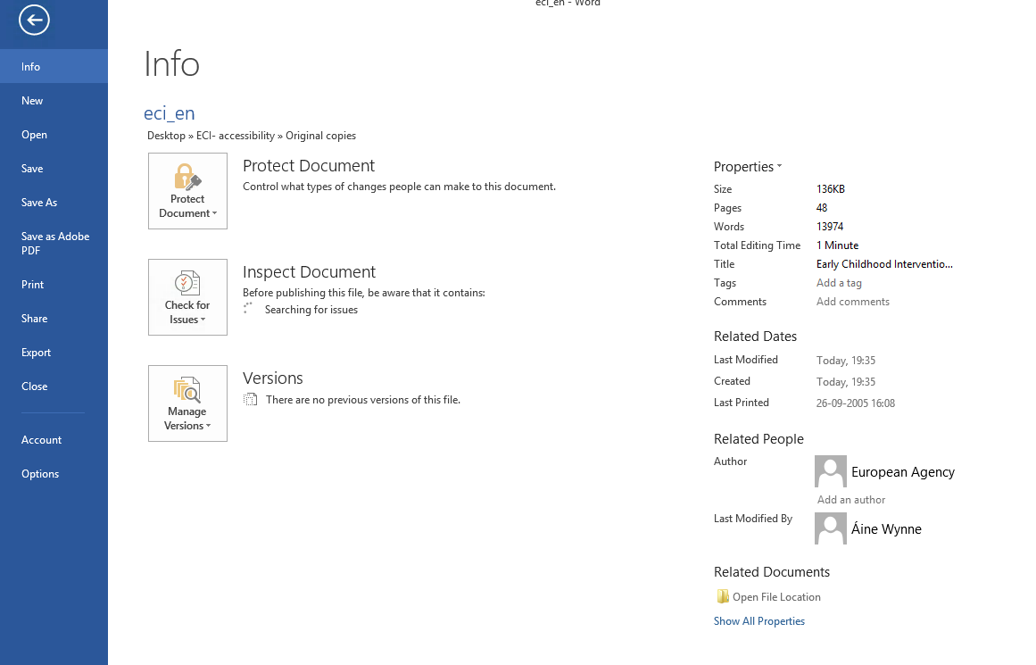
Word accessibility checker (step 1)
Notes:
Word accessibility checker (step 1)
Screen displayed in Microsoft Word when the user selects 'File' and 'Info'. The options 'Protect Document', 'Check for Issues' and 'Manage Versions' appear.

Slide 12
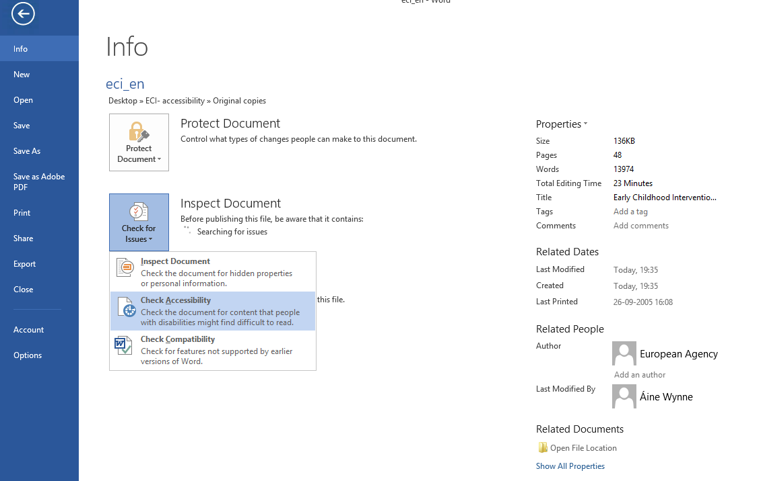
Word accessibility checker (step 2)
Notes:
Word accessibility checker (step 2)
Screen displayed in Microsoft Word when the user selects 'Check for Issues'. The options 'Inspect Document', 'Check Accessibility' and 'Check Compatibility' appear.

Slide 13
Word accessibility checker results
Notes:
Word accessibility checker results
The results show an error owing to missing alt text and warnings relating to infrequent headings and unclear hyperlink text.

Slide 14
PDF accessibility checker (step 1)
Notes:
PDF accessibility checker (step 1)
In Adobe Acrobat Pro, click on Tools, Accessibility and Full Check

Slide 15
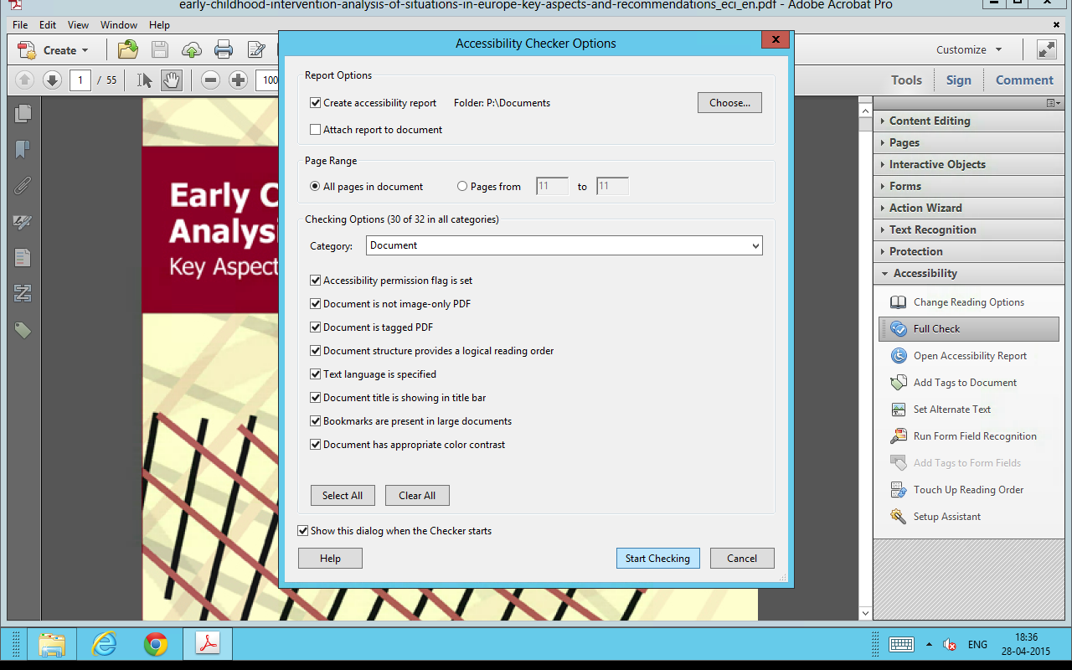
PDF accessibility checker (step 2)
Notes:
PDF accessibility checker (step 2)
In the Accessibility Checker Options make sure all options are selected and click Start Checking.

Slide 16
PDF accessibility checker results
Notes:
PDF accessibility checker results
The accessibility checker shows the following errors:
Tagged PDF
Primary language
Title
Bookmarks
Tab order
Other elements alternate text

Slide 17
Making the publication accessible (1)
Key points based on Step 1, Sections 1 and 2 of the Guidelines:
Font size 12 used throughout
Acronyms ECI, DG, UNESCO, WHO and ICF explained
Created and applied new styles
Added more headings to improve structure
Used bullets and numbering in lists
Set main language as English and marked foreign words as the corresponding language
Notes:
Making the publication accessible (1)
Key points based on Step 1, Sections 1 and 2 of the Guidelines:
Font size 12 used throughout
Acronyms ECI, DG, UNESCO, WHO and ICF explained
Created and applied new styles
Added more headings to improve structure
Used bullets and numbering in lists
Set main language as English and marked foreign words as the corresponding language

Slide 18
Making the publication accessible (2)
Added summary of content to tables with ISBN and Agency contact details
Added in ‘Email’ before the two Agency email addresses
Used embedded links throughout instead of URLs
Added a caption and alt text to Figure 1 (formerly known as ‘the following scheme’)
Metadata: document title, author and keywords added
Notes:
Making the publication accessible (2)
Added summary of content to tables with ISBN and Agency contact details
Added in ‘Email’ before the two Agency email addresses
Used embedded links throughout instead of URLs
Added a caption and alt text to Figure 1 (formerly known as ‘the following scheme’)
Metadata: document title, author and keywords added

Slide 19
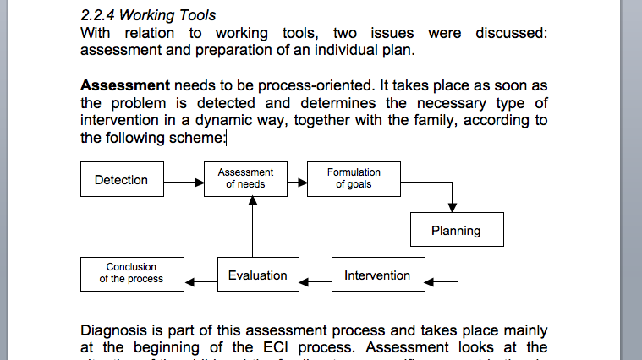
Images and alt text (before)
Notes:
Images and alt text (before)
The image appears without a caption and is referred to as 'the following scheme'

Slide 20
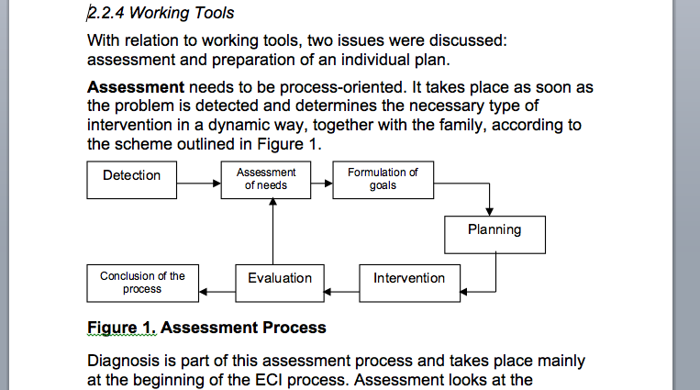
Images and alt text (after)
Notes:
Images and alt text (after)
The image now has a caption and is referred to as 'Figure 1' in the text. Alt text has also been added.
The alt text reads: The figure consists of seven text boxes, linked by single direction arrows. The first one says 'Detection', with an arrow going to 'Assessment of needs', followed by an arrow going to 'Formulation of goals', followed by an arrow going to 'Planning', followed by an arrow going to 'Intervention', followed by an arrow going to 'Evaluation', followed by an arrow going to 'Conclusion of the process'. Another arrow from the 'Evaluation' textbox points back to the 'Assessment of needs' textbox.

Slide 21
Non-editable image
Notes:
Non-editable image
ECI report cover

Slide 22
Alt text
The Guidelines explain that alt text is ‘a description that shares the same message as the visual image’.
According to the WebAIM resource in Step 1, Section 2, 2.2 of the Guidelines, alt text should:
Be accurate and equivalent (presenting the same content and function of the image).
Be succinct. Present the image’s content and function as succinctly as appropriate.
NOT be redundant or provide the same information as text within the context of the image.
NOT use the phrases ‘image of’ or ‘graphic of’. However, if the fact that it is a photograph or illustration, etc., is relevant, it may be useful to include it.
Notes:
Alt text
The Guidelines explain that alt text is ‘a description that shares the same message as the visual image’.
According to the WebAIM resource in Step 1, Section 2, 2.2 of the Guidelines, alt text should:
Be accurate and equivalent (presenting the same content and function of the image).
Be succinct. Present the image’s content and function as succinctly as appropriate.
NOT be redundant or provide the same information as text within the context of the image.
NOT use the phrases ‘image of’ or ‘graphic of’. However, if the fact that it is a photograph or illustration, etc., is relevant, it may be useful to include it.

Slide 23
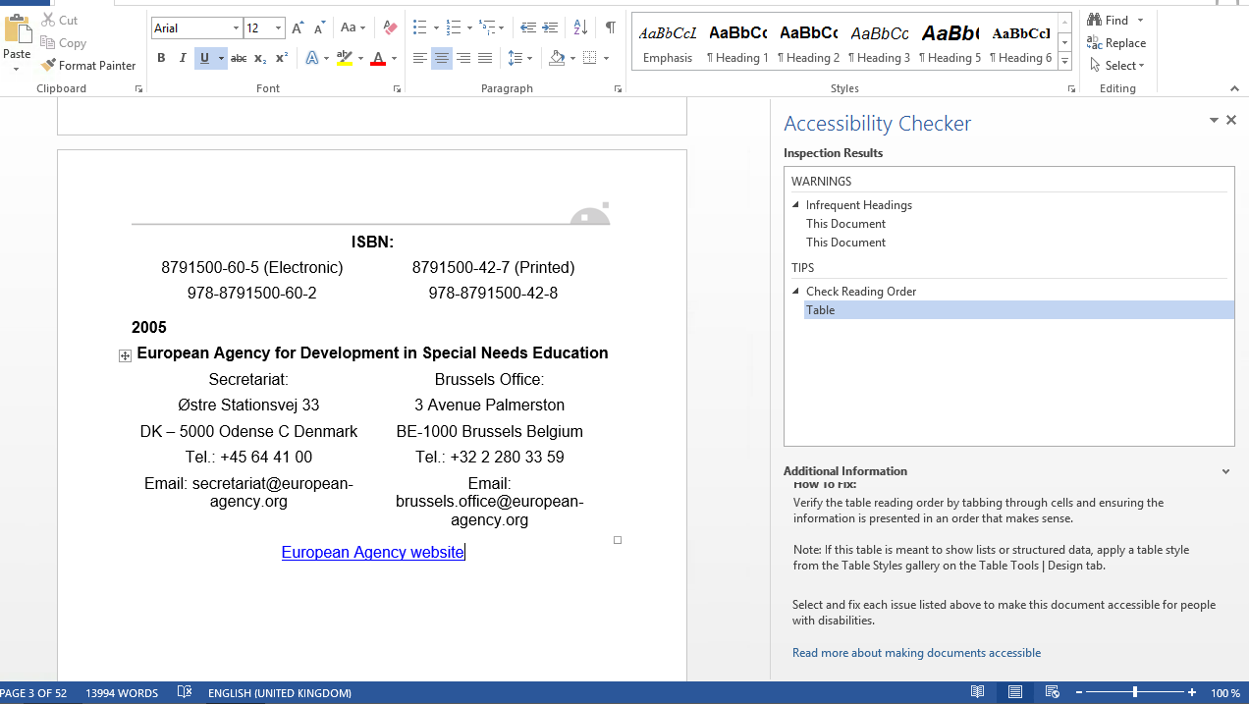
Word accessibility checker results (after)

Slide 24
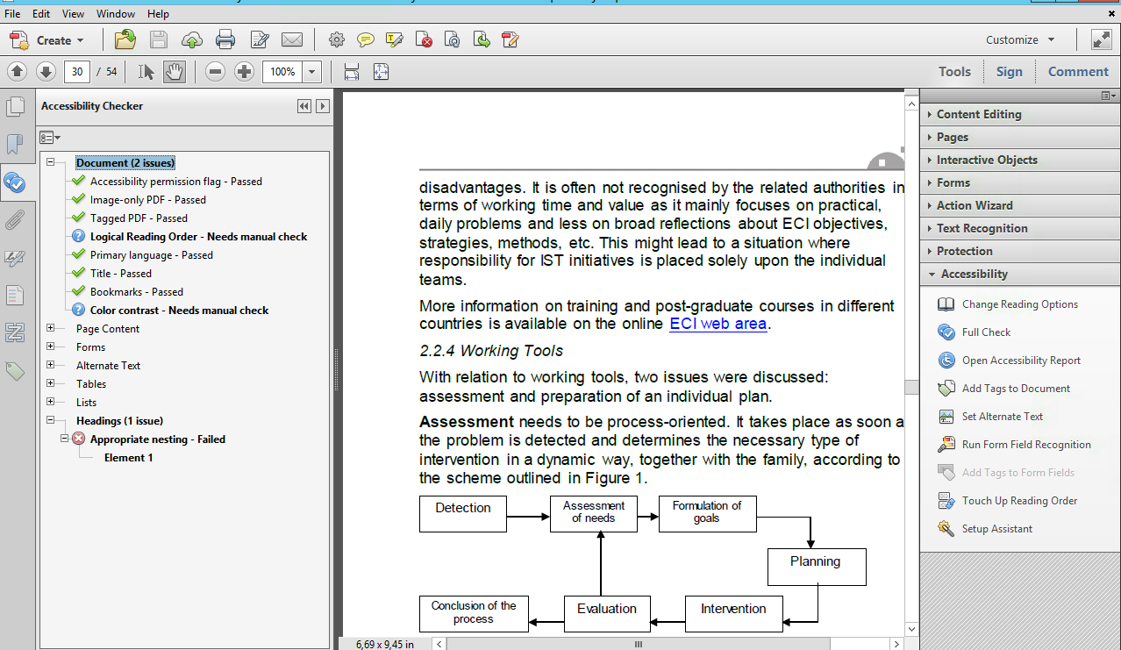
PDF accessibility checker results (after)

Slide 25
Questions & Volunteers

Slide 26
Contact Us
www.ict4ial.eu
This project has been funded with support from the European Commission. This project reflects the views only of the author, and the Commission cannot be held responsible for any use which may be made of the information contained therein.
European Agency for Special Needs and Inclusive Education
DAISY Consortium
European Schoolnet
Global Initiative of Inclusive ICTs
International Association of Universities
United Nations Educational, Scientific and Cultural Organization
European Agency for Special Needs and Inclusive Education
www.european-agency.org
secretariat@european-agency.org
Notes:
http://www.ict4ial.eu
This project has been funded with support from the European Commission. This project reflects the views only of the author, and the Commission cannot be held responsible for any use which may be made of the information contained therein.
European Agency for Special Needs and Inclusive Education http://www.european-agency.org
DAISY Consortium http://www.daisy.org
European Schoolnet http://www.eun.org
Global Initiative of Inclusive ICTs http://www.g3ict.com
International Association of Universities http://www.iau-aiu.net
United Nations Educational, Scientific and Cultural Organization http://www.unesco.org
Insert name of Presenter
Insert contact details of Presenter

