Slide 1
"New Frontiers For
Digital Accessibility In Academia"
Information Accessibility for Learning
from Development to Implementation of Guidelines
2016 International Seminar, Milano, Italy
Presented by Christopher M. Lee, PhD., Department Head
Georgia Institute of Technology
AMAC Accessibility Solutions | Research Center
@leecm363 | @AMAC_Tweet | amacusg.org | Skype. christopher1914

Slide 2
New Frontiers For Digital Accessibility In Academia
Highlight the current and future landscape for digital accessibility.
AMAC Accessibility Solutions and Research Center
R&D Initiatives
On-line learning
Teaching accessibility
Highlight an ICT accessibility research initiative.
Provide resources
Notes:
2

Slide 3
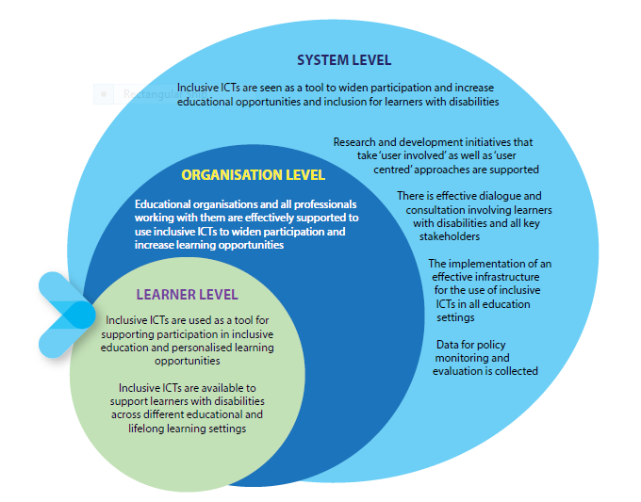
Convention on the Rights of Persons with Disabilities (CRPD)
CRPD
Protect the rights and dignity of persons with disabilities.
Adopted by the United Nations General Assembly December, 2006 as the 8th Human Rights Treaty.
158 countries have signed and 147 ratified it as of August 2014.
Defines far reaching accessibility obligations for all areas of ICTs impacting 147+ States Parties (80% of the global populations).
Model Policy for Inclusive ICT’s IN Education for Person with Disabilities
A framework for policy makers to develop national policies in cooperation with relevant stakeholders.
The Model offers a blueprint and auditing tool to support educational environments.
Based on the work of an international team of experts from all continents. Sponsored by UNESCO, European Agency and G3ict.
Notes:
3

Slide 4
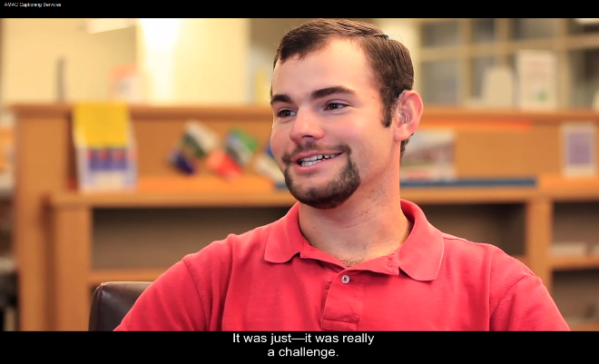
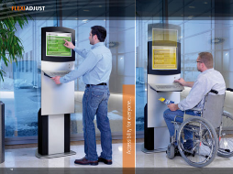
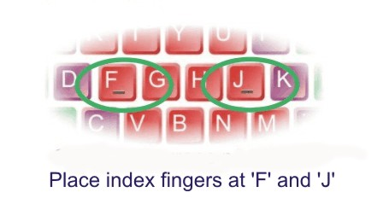
Universities ICT Accessibility Challenges
Technology Touch Points
Websites
Videos
Software
Electronic kiosks
Computers
Access to published works
Universal Design for Learning

Slide 5
A Centralized Research and Development Training Center
2,700 Colleges
Results
Cost Savings
45% product reuse rate
Data – for better decisions
R&D services and products
Services/Products
E-text books
Braille
Captioning
AT Evaluations
ICT Instruction
Web Evaluations
Data collection
Quality Assurance and Evaluations
Enterprise Resource Planning Software
Investment: Distribute Equal Services | Reduce Costs | Reduce OCR Complaints | Improve Quality of Service | Improve Timeliness
Notes:
Will rework slide.

Slide 6
Disability and Inclusive Education Accessible Electronic Materials Global Challenges
Copyright Challenges
Lack of accessible marketplace materials.
Lack of one standard flexible digital format.
Lack of understanding on accessible course material.
Lack of LMS integration of accessible course material.
Lack of post-production conversion low-cost technology.
Lack of DRM access with assistive technology.
Lack of accessibility guideline integration.
eXchange (ONIX) accessibility metadata.

Slide 7
Frontiers for Digital Accessibility
Creation of a standardized document accessibility profile called the “A11y Label”.
The A11y Label is for disclosing the specific accessibility features of digital textbooks.
Similar to a nutrition label for packaged food, this A11y Label, produced by an application or ‘app,’ will be created from ONIX international standards used by book publishers and distributors.
A checklist of features enabled in the existing Online Information eXchange.
The A11y Label will be available on a web portal, and accessible from computers, tablets, and mobile devices.

Slide 8
Inclusive Education Tools
Accessible Textbook Finder
The AccessText Accessible Textbook Finder searches multiple vendors by ISBN or title, and provides the combined results with links to the source.

Slide 9
Universities ICT Accessibility Challenge | Research Surveys
Qualtrics Audit
Surveygizmo Audit
Accessibility statement provided
Qualtrics rendered unusable
Very difficult to navigate with JAWS and shortcuts
Invisible columns which makes them confusing to navigate
Table and grid are accessible
Color contrast
Checkboxes, combo boxes, headings, radio buttons and edit boxes were all accessible via a screen reader

Slide 10
Universities ICT Accessibility Challenges Massive Online Course (MOOC)
U.S. Justice Department reaches settlement with edX, provider of Massive Open Online Courses.
edX platform accessibility overview video
edX is responsible for making its website, online platform and mobile applications accessible under the Americans with Disabilities Act.
Georgia Tech | AMAC ICT Accessibility MOOC.
Course on in button
Navigations and links
Color contrast

Slide 11
Universities ICT Accessibility Challenges |Procurement
ICT adoption
Organizations should have INTERNAL accessibility requirements for the type of ICT they intend to buy.
Accessibility should be considered at the earliest stage of the procurement process.
Organizations should work with disability-related groups in product design and product trials.
Organizations should undertake reasonable efforts to test access solutions with PWDs.

Slide 12
Teaching Accessibility
Teaching #a11y is creating models for teaching and training students of technology to create accessible experiences in university settings.
Private industry companies addressing accessibility through the teaching #a11y.
Challenge of preparing designers, engineers and researchers to think and build inclusively.
Academic programs in design, engineering and HCI will be seeking ways to better prepare students to address the needs of diverse populations.

Slide 13
The 2016 Post-Secondary ICT Accessibility Research Initiative
Sponsored by G3ict and Georgia Tech’s AMAC Accessibility.
The purpose is to identify global successful practices in higher education for ICT accessibility, which are aligned with the United Nations CRPD.
The timeframe is from February 2016 through June, 2016.
Survey and distributions task force recruitment begins now.
The findings highlighted at the M-Enabling Summit.
Contact Christopher Lee or Zerrin Ondin | AMAC Research Scientist.

Slide 14
Presentation Resources
Convention on the Rights of Persons with Disabilities (CRPD).
The Global Initiative for Inclusive ICT’s (G3ict)
G3ict M-Enabling Summit, June 13-14 | Washington, DC.
Model Policy for Inclusive ICT in Education for Persons with Disability, joint publication UNESC|G3ict
E-Accessibility Policy Toolkit for Persons with Disabilities | International Telecommunication Union | G3ict
International Association of Accessibility Professionals (IAAP)
#Ally Textbooks Facts Label | Center for Accessible Materials Innovation (CAMI)
Georgia Tech |AMAC | Web Accessibility Group (WAG)
Association of America Publisher | Georgia Tech |AMAC | The AccessText Network | Accessible Textbook Finder
Bookshare
DAISY Consortium
Universal Design for Learning | CAST

Slide 15
"New Frontiers For
Digital Accessibility In Academia"
Information Accessibility for Learning
from Development to Implementation of Guidelines
2016 International Seminar, Milano, Italy
Presented by Christopher M. Lee, PhD., Department Head
Georgia Institute of Technology
AMAC Accessibility Solutions | Research Center
@leecm363 | @AMAC_Tweet | amacusg.org | Skype. christopher1914

