Slide 1
EU approach to e-Accessibility
.............................................................................................................................................................................................................
Alejandro Moledo, EDF New Technologies and Innovation officer
ICT for Information Accessibility in Learning – 28 May 2015
r

Slide 2
About the European Disability Forum
Umbrella organisation
80 million Europeans with disabilities in Europe (15% EU population)
Organisation OF persons with disabilities, RUN BY persons with disabilities
Fight against discrimination and promote the Human Rights of persons with disabilities
Advocacy organisation at European level
Closely work with the EU, the Council of Europe and the UN

Slide 3
Digital Agenda for Europe, 2010
Available here
Pilar VI: Enhancing digital literacy, skills and inclusion
Action 63: Evaluate accessibility in legislation – EAA
Action 64: Ensure accessibility of public sector bodies’ websites – Web Accessibility Directive
Action 65: Helping disabled people to access content – Marrakech Treaty

Slide 4
Digital Single Market Strategy, 2015
Available here
16 actions
Lack of inclusive approach
Opportunities for persons with disabilities:
Audiovisual Media Services Directive
Universal Services Directive
e-Commerce Directive
EDF & AGE Platform recommendations for an Inclusive Digital Single Market

Slide 5
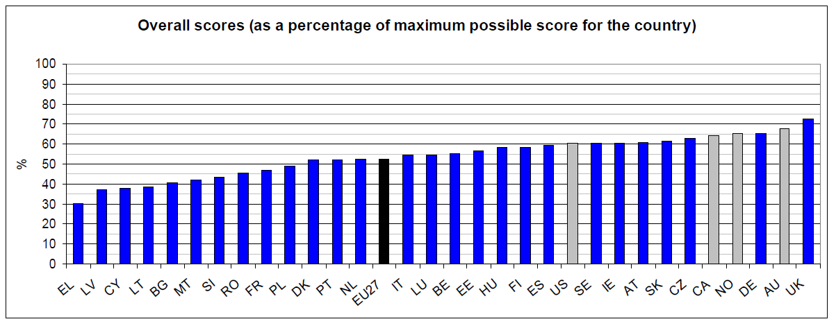
Web Accessibility
Source: “Study on assessing and promoting e-accessibility”, available at: http://ec.europa.eu/digital-agenda/en/news/study-assessing-and-promoting-e-accessibility

Slide 6
Proposal for a Directive on the Accessibility of Public Sector Bodies’ Websites
European Commission:
12 types of websites
No enforcement body
Monitoring
Reporting annually
European Parliament:
All public sector bodies’ websites + services of general interest (annex)
Apps + Authoring tools
Enforcement body
Monitoring and reporting
Penalties
Expert group at EU level
Involvement of persons with disabilities
Gradual implementation
And what about the Council?
EDF 2nd position paper

Slide 7
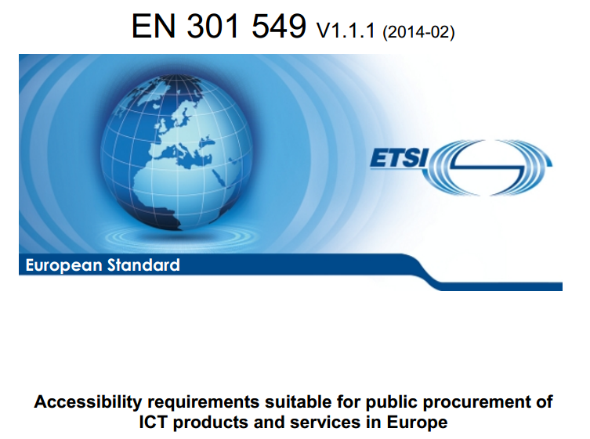
Accessibility requirements suitable for public procurement of ICT products and services in Europe available online

Slide 8
Why is this standard important?
1st European Standard on e-Accessibility
Technical specifications for equal access to ICT:
websites, emails, documents, books, videos, communication devices, ATMs, self-service machines…
Public Procurement Directive article 42 (available here)
Harmonised Standard to prove compliance with the future Web Accessibility Directive (?)
Relationship with the US Rehabilitation Act Section 508 (under revision) and other international standards
All the information is available in the EDF Toolkit for the promotion of the EN 301549

Slide 9
Content:
Scope
Definitions and abbreviations
Functional performance (informative)
Generic requirements:
ICT with two-way voice communication
ICT with video capabilities
Hardware
Web = WCAG 2.0 Level AA = ISO 40500;2012
Non-web documents
Non-web software
Documentation and support services
ICT providing relay or emergency services
Annex A: WCAG 2.0
Annex B: Relationship between requirements and functional performance statements
Annex C. Determination of compliance (normative)

Slide 10
What else is missing?
European Accessibility Act
Horizontal Equal Treatment Directive
Opportunities in the DSM list of actions
Audiovisual Media Services Directive
e-Commerce Directive
Regulation on Consumer Protection Cooperation
Universal Services Directive
e-Government Action Plan

Slide 11
Other proposals
Effective mainstreaming of accessibility in all EU legislation and policies and organising training of EU staff is also essential
Public information in alternative formats
Specific indicators to monitor the implementation of accessibility provisions in EU legislation, in particular under the Structural Funds Regulation No 1303/2013
EU web portal on Accessible Public Procurement
Make sure persons with disabilities have equal access and choice to telecom products and services, including 112 emergency services

Slide 12
THANK YOU
.............................................................................................................................................................................................................
For more information please contact EDF Secretariat: Alejandro Moledo, EDF New Technologies and Innovation officer
alejandro.moledo@edf-feph.org

